Slide 1
Blood Borne
Pathogen Training
Intro to Nursing 300

Slide 2
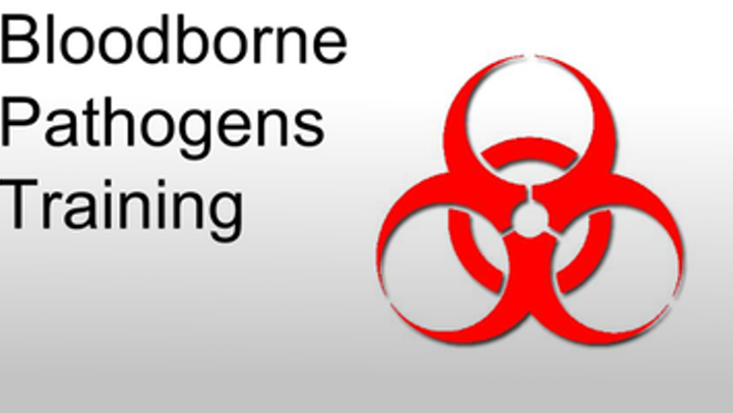
Bloodborne Pathogen & Safety Training: Objectives
Identify bloodborne pathogens and how are they transmitted
Recognize the workplace activities that could expose you to blood and other possibly infectious materials
State practices that will prevent or reduce exposure including equipment and safer medical devices, work practices and personal protective equipment
Identify the appropriate Personal protective equipment to utilize.
Become familiar with GCU’s Exposure Plan and the steps to follow if exposed to a BBP.
Identify vaccinations that can protect a healthcare worker from BBP.

Slide 3
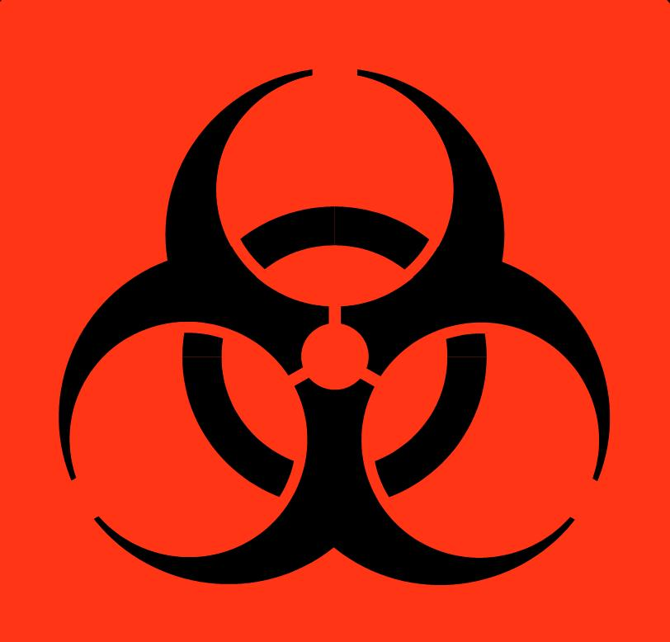
Bloodborne Pathogen & Safety Training: Bloodborne Pathogens & Transmission
Bloodborne Pathogen– a pathogenic microorganism present in human blood that can lead to diseases.
BBP of primary concern:
  Hepatitis B (HBV)
  Hepatitis C (HCV)
  Human Immunodeficiency Virus (HIV)
Other BBP diseases
  Caused by viruses or bacteria
  Circulate in blood at some phase; capable of being transmitted
  Most are rare in the U.S.
    Examples: Hepatitis D, Syphilis, Malaria.

Slide 4
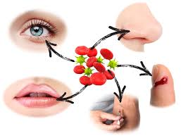
Bloodborne Pathogen & Safety Training: Bloodborne Pathogens & Transmission
Contamination Sources: Blood, human body fluids, and unfixed tissue or organ from human
Spread occurs through:
  Direct contact
  Indirect contact
  Respiratory transmission
  Vector-borne transmission

Slide 5
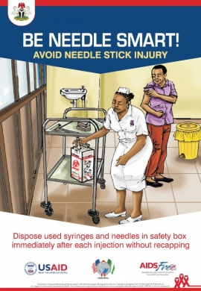
Bloodborne Pathogen & Safety Training: Workplace Activities
How exposure occurs:
  Needlesticks
  Cuts from other contaminated sharps
  Contact with mucous membrane or broken skin with contaminated blood and/or bodily fluids
Occupations at risk for BBP---Health care workers!
Notes:
In most work environments, transmission occur because of accidental puncture from contaminated needles, broken glass, or other sharps. Contact with broken or damaged skin and infected body fluids; or contact between mucous membranes and infected body fluids.
Anytime there is blood-to-blood contact with infected blood or body fluids there is a slight potential for transmission.

Slide 6
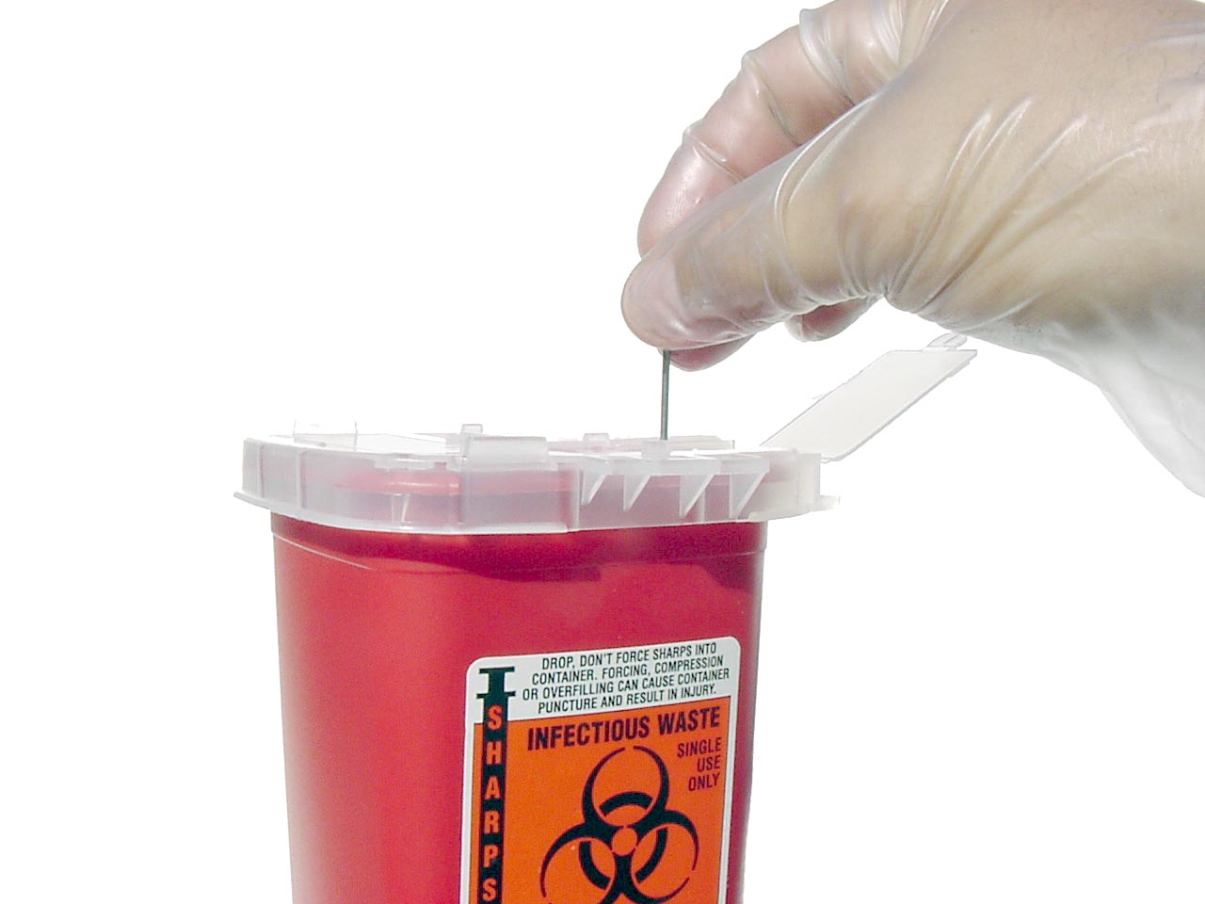
Bloodborne Pathogen & Safety Training: Safe practices
STANDARD PRECAUTIONS need to be followed!!!
All blood and bodily fluids should be treated as if they are contaminated.
Use safe medical devices (safety needles or needless systems)
Sharps disposal containers (should be close by)
Appropriate and adequate Hand Hygiene
Notes:
Bloodborne Pathogen Standard 29 CFR 1910.1030(d)(1) requires:
Employees to observe Universal Precautions to prevent contact with blood or other potentially infectious materials (OPIM).
Under circumstances in which differentiation between body fluid types is difficult or impossible, all body fluids shall be considered potentially infectious materials.
Treat all blood and other potentially infectious materials with appropriate precautions such as:
Use gloves, masks, and gowns if blood or OPIM exposure is anticipated.
Use engineering and work practice controls to limit exposure.
1996, the term Universal Precautions was replaced with the term standard precautions.
What is the difference?
Universal Precautions: This is the practice of avoiding contact with bodily fluids, by means of the wearing of nonporous articles such as gloves, goggles, and face shields. The practice was introduced in 1985-88.
The Centers for Disease Control (CDC) defines Standard Precautions as “ A set of precautions designed to prevent transmission of HIV, Hepatitis B virus (HBV), and other bloodborne pathogens when providing first aid or health care. Under standard precautions, blood and certain body fluids of all patients are considered potentially infectious for HIV, HBV and other bloodborne pathogens.
“Studies show that as many as one-third of all sharps injuries occur during disposal. Nurses are particularly at risk, as they sustain the most needlestick injuries. The Centers for Disease Control and Prevention (CDC) estimates that 62 to 88 percent of sharps injuries can be prevented simply by using safer medical devices” (OSHA n.d.)
Washing hands as promptly and thoroughly as possible between patient contacts and after contact with blood, body fluids, secretions, excretions, and equipment or articles contaminated by them is an important component of infection control and isolation precautions.”

Slide 7
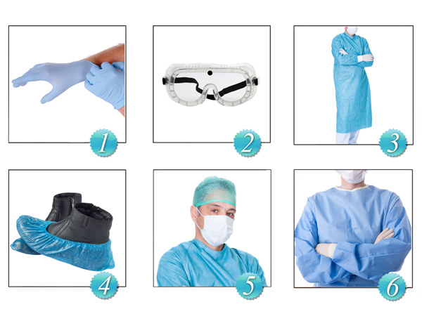
Bloodborne Pathogen & Safety Training: PPE
Gloves
Masks
Aprons/Smocks/Gowns
Face Shields
Mouthpieces
Safety glasses
CPR pocket masks
Other guidelines
Notes:
Some general PPE Guidelines include, but not limited to:
Wear gloves, when handling chemicals and/or body fluids.
Wear safety shoes/boots/covers if hazardous substance is likely to splash.
Wear an apron/gown/coveralls- if hazardous substance is likely to splash.
Use a respirator: when hazardous substance is airborne such as tuberculosis.
Wear hearing protection: for loud noises such as from equipment.
Remove PPE carefully to avoid contaminating yourself.
Dispose of PPE in designated containers before leaving area.

Slide 8
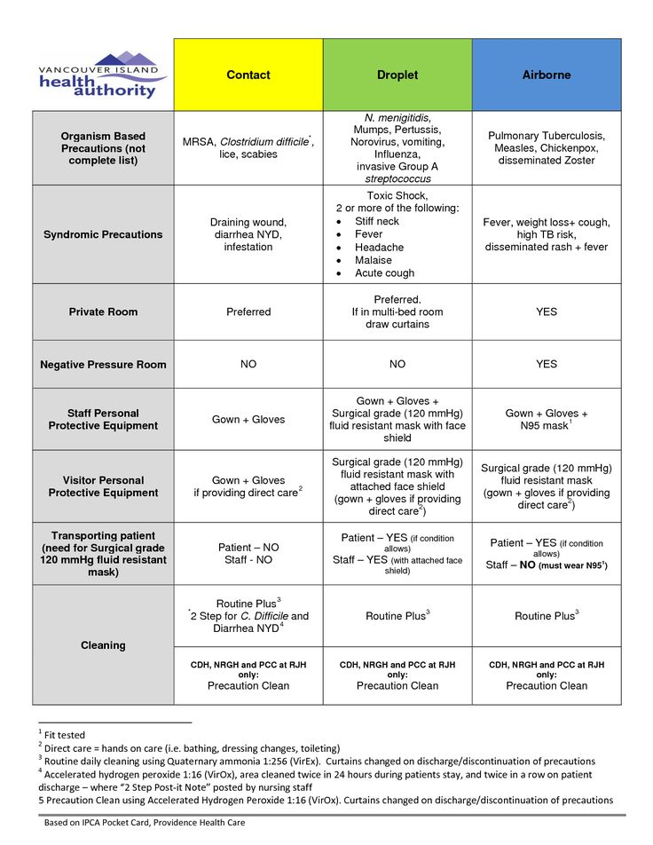

Bloodborne Pathogen & Safety Training: PPE & Isolation Precautions
Different types of Isolation precautions
*Contact
* Droplet
* Airborne

Slide 9
Bloodborne Pathogen & Safety Training: Exposure Plan
https://www.gcumedia.com/lms-resources/student-success-center/documents/conhcp/conhcp-guidelines-for-undergraduate-field-experiences.pdf
Page 16-18 (Read and review)
Also University Policy Handbook—page 55 “Bodily Fluids Exposure and/or Injury During Field Experiences”

Slide 10
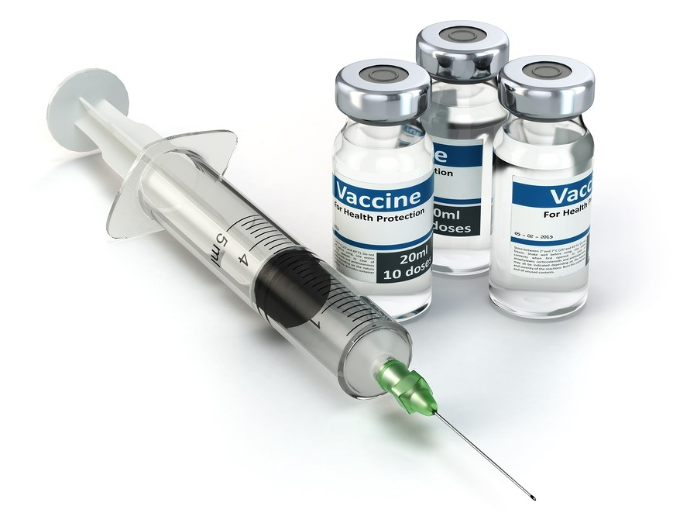
Bloodborne Pathogen & Safety Training: Controlling Exposures with Vaccinations
Hepatitis B vaccination
NO vaccinations for Hepatitis C or HIV

